Slide 1

SUPPLY CHAIN MANAGEMENT FAUJI FOUNDATION CEMENT SECTOR COMPANIES

Slide 2
Supply Chain Management
Assessment of Current Supply Chain Management
Integrated Supply Chain Management Model – Recommendation

Slide 3
Assessment of Current Supply Chain Management

Slide 4
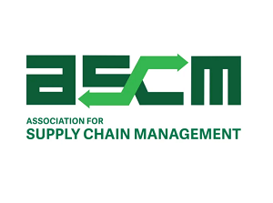
Built Upon Global Best Supply Chain Standards
Global best Supply Chain Management standards will guide to assess and improve FCCL & ACL supply chain management.

Slide 5
Supply Chain Maturity Model
Association for Supply Chain Management define four level of supply chain maturity, we use this model to assess the current stage of FCCL & ACL
Stable
Stage 1
Multiple Dysfunction
Stage 3 Integrated Enterprise
Stage 2
Semi Functional Enterprise
Stage 4
Extended Enterprise

Slide 6
Supply Chain Maturity Levels
Association for Supply Chain Management define six capabilities against four stages to assess the maturity level
Capability | Stage 1: Multiple Dysfunction | Stage 2: Semi-Functional Enterprise | Stage 3: Integrated Enterprise | Stage 4: Extended Enterprise
Internet | Static web sites | Online catalogs /order booking | Intranets across all functions | Correspondence with Supplier and Customer
Integration | None; no teamwork | Internal process partially Integrated | Internal process full Integrated | SC networks; process integration
Supply Chain Planning | Little information exchange | Informal, Low initiative coordination | Formal planning with Supplier | Integrated global planning; Global Supply chain
Production Scheduling | Basic MRP(Material Requirement Planning) | MRP-II (Manufacturing Requirement Planning) | ERP( Enterprise Resource Planning) MRP(manufacturing requirement planning) | Externally integrated ERP
Integration with Suppliers | Fax/phone | EDI( electronic data interchange) | EDI( electronic data interchange) with large suppliers | VMI( vendor manage inventory); online RFQ( request for quotation
Integration with Customer | Fax/phone | EDI( electronic data interchange) | ATP ( available to promise) | CTP ( capable to promise)

Slide 7
FCCL & ACL current supply chain maturity level
We assess FCCL & ACL supply chain maturity level with the help of six different capabilities
Sr. # | Capability | FCCL & ACL Supply Chain Maturity Level | Stage
1 | Internet | Static web sites | 1
2 | Integration | Internal process partially Integrated | 2
3 | Supply Chain Planning | Informal, Low initiative coordination | 2
4 | Production Scheduling | MRP-II (Manufacturing Requirement Planning) | 2
5 | Integration with Suppliers | Fax/phone | 1
6 | Integration with Customer | Fax/phone | 1
 | Average |  | 1.5

Slide 8
Assessment of Current State of Supply Chain Management at FCCL and ACL
Sr. # | Observation |  | Implication | Recommendation
 | FCCL | ACL
1 | It is observed that all functional areas of supply chain (Procurement, Dispatch, Warehouse and Logistics) operate in different silos |  | This may pose difficulty in achieving efficiencies in the functional areas of Supply Chain Management | It is recommended to integrate the functional areas under one umbrella of Supply chain management for better efficiency and effectiveness to improve customer fulfillment and cash flow.
2 |  | It is observed that dispatch section at plant is part of Admin department while reporting to Marketing Department. | Mis alignment of function may lead to inefficiency and ineffectiveness | It is recommended to align the dispatch department directly with the marketing department for better efficiency and effectiveness.

Slide 9
Assessment of Current State of Supply Chain Management at FCCL and ACL
Sr. # | Observation |  |  | Implication |  | Recommendation
 | FCCL | ACL
Order Management
3 | Order Booking Process have a lot of room for improvement with regard to efficient and effective booking with a focus on optimization of dispatch time and factors maintaining customer satisfaction standards |  |  |  | Customer retention becomes a challenge if the order is not served efficiently and effectively. It also poses a challenge in developing new geographical territories | It is recommended to introduce digital tools to reduce lead time starting from order booking till dispatch.
4 | The existing payment model poses a limitation in achieving efficiencies in order service and eventual delivery to the customer |  | The existing payment model poses a limitation in achieving efficiencies in order service and eventual delivery to the customer |  | May result in lost customer base and opportunity for leveraging incremental sales | It is recommended to introduce Digital Financial Solution-DFS

Slide 10
Assessment of Current Supply Chain Management
Sr. # | Observation |  | Implication | Recommendation
 | FCCL | ACL
Order Management
5 | The bank deposit slip is admitted as customer order request. | The bank deposit slip is admitted as customer order request. | This may cause possible errors while generating Customer Order Form since the basic document i.e. customer order request is not provided by the customer. | It is recommended to introduce standard customer order request form, it will help in maintaining accuracy in collecting the details of the order i.e. order qty, order date, payment instrument, dealer name, code, shipment address, packing details, source of dispatch, and transportation mode.
6 | Customer order form is generated in ERP by marketing/sale support department before payment confirmation by the finance department | Customer order form is generated in ERP by marketing/sale support department before payment confirmation by the finance department | This may create inefficiencies in managing order processing | It is recommended to generate customer order in ERP after payment confirmation by the finance department.

Slide 11
Assessment of Current Supply Chain Management
Sr. # | Observation |  | Implication | Recommendation
 | FCCL | ACL
7 | Packing details are missing in customer order form. | Packing details are missing in booking order form. | Absence of packing details may cause doubt, create discrepancy and inaccuracy of data | It is recommended to mention packing details in customer order form. it would bring more accuracy. In data compilation.
8 | Absence of key performance indicators in dispatch section i.e. Delivery in full on time-DIFOT ( perfect order, accurate order, Inventory availability, warehouse service level, carrier deliveries, customer order acceptance, accurate invoice) |  | May effect achieving cost efficiencies, accuracy and reducing dispatch lead time.. | It is recommended to implement DIFOT to achieve efficiencies.
Authority Letter
9 | The study reveals that presently there are different formats of authority letters /permits in practice in FCCL | Not provided | Use of non-standard formats may lead to misinterpretation of data resulting in inaccuracy of information. | The format of the Authority Letter/Permit may be standardized for all the customers for improved reporting of information.

Slide 12
Assessment of Current Supply Chain Management
Sr. # | Observation |  | Implication | Recommendation
 | FCCL | ACL
ERP
10 | It is observed that the ERP tool is not aligned with the details of the finished goods inventory, dispatch details and order management. | It is observed that the ERP tool is not aligned with the details of the finished goods inventory, dispatch details and order management. | Non-availability of real time information on finished goods inventory may lead to overbooking thus causing delays in loading of goods for the customers in the waiting line. | ERP module may reflect real time information on Finished Goods Inventory, Dispatch details and different stages of order process management.
11 | There is an absence of information dashboard providing real time information on dispatch & pending order, carriage back log, carriage in pipeline etc. | There is an absence of information dashboard providing real time information on dispatch & pending order, carriage back log, carriage in pipeline etc. | Absence of dashboard leads to In-visibility of real time progress of dispatch | It is recommended to introduce real time visibility through dashboard in the ERP

Slide 13
Assessment of Current Supply Chain Management
Sr. # | Observation |  | Implication | Recommendation
 | FCCL | ACL
Loading Gate Entry
12 | Absence of proper vehicle inspection process i.e. check list of items to be checked, such as fitness of the vehicle, cleaning, rope, spare tyre, canvas (tarpal) and etc. |  | The unfit vehicle without the supporting material may cause delays in delivery and/or damage of the goods in transit | It is recommended to Implement proper vehicle inspection before loading of goods

Slide 14
Assessment of Current Supply Chain Management
Sr. # | Observation |  | Implication | Recommendation
 | FCCL | ACL
Weigh Bridge Risk
13 | Absence of guide line at weigh bridge for truck drivers, how to enter/exit the w/b platform | - | Absence of guidelines may cause damage to weigh bridge, error in weight calculation and may cause dispatch disturbance | It is recommended that guidelines for the drivers may be clearly mentioned at the entrance via a notice board to ensure accurate and error free dispatches.
14 | Absence of proper light arrangement, security cameras & cat lights at weighbridge . | - | Absence of these arrangement may cause security breach, accident and or damage to property or the vehicle. | It is recommended to that safety & security standards at weighbridge & along road side in/out side of plant area may be maitained.

Slide 15
Assessment of transportation and freight
Sr. # | Observation |  | Implication | Recommendation
 | FCCL | ACL
Transportation arrangement and analysis
15 | It is observed that there is a variance of 22% between the approved freight rates and the going market rates. |  | High cost of transportation may limit the penetration in new territories | It is recommended to optimize the freight cost to achieve the better placement of product.

Slide 16
FCCL & ACL Current Marketing & Dispatch Interface
This model depict current Marketing and Dispatch Interface
Marketing
Product
Price
Promotion
Place
(Customer Service Level)
Transportation Cost
Order Processing & Communication Costs

Slide 17
Assessment of freight cost FCCL Average Freight Rs./ Ton.
High cost of transportation may limit the penetration in new territories
Category | FY 16-17 (Rs./ton) | FY 17-18 (Rs./ton) | FY 18-19 (Rs./ton)
Freight for project (Bag Packing) | 815 | 1,080 | 1,665
Freight for project (Bowser/Bulker) | 767 | 870 | 1,570
Freight for Dealer (Bag Packing) | 890 | 1,160 | 1,820
Average (Overall) | 824 | 1,036 | 1,685
Average Freight Cost = Rs.1685/ton
= Rs.84.25/bag

Slide 18
FCCL Freight Rate Analysis with respect to Current Market Freight
Sr.# | Destination | FCCL Freight Rs./bag | Open Market Rs./bag Dated 1st Sep, 19 (Fuel price increase Rs.5.35/ltr.(3.95%) translate in freight @1.38% | Open Market/bag Dated 1st Oct, 19. No change in fuel
1 | Islamabad | 54 | 35 | No Change
2 | Rawalpindi | 54 | 35 | No Change
3 | Peshawar | 63 | 40 | No Change
4 | Gujranwala | 93 | 65 | No Change
5 | Lahore | 93 | 75 | No Change
6 | Faisalabad | 98 | 80 | No Change
7 | Sargodha | 100 | 65 | No Change
8 | Multan | 100 | 80 | No Change
9 | Bahawalpur | 92 | 95 | No Change
10 | Karachi | 137 | 120 | No Change
 | Avg. Freight Rs./bag | 88 | 69 | 22% variance from Market

Slide 19
FCCL Dispatch Staff Productivity Analysis & Resource Optimization
This analyses can help to optimize the resources at dispatch section on plant site.
 | FCCL | ACL-Nizampur | ACL-Wah
Total dispatch for 2018-19 in tons | 3,037,623 | 1,292,752 | 1,060,743
Total dispatch staff | 23 | 17 | 10
Average dispatch staff productivity /year | 132,070 | 76,044 | 106,074
Average productivity in tons/month | 11,006 | 6,337 | 8,839
Average productivity in tons/day | 478 | 275 | 384
Average productivity in term of vehicle documentation/ day | 16 | 09 | 13
Source: Received from FCCL and ACL numbers are round

Slide 20
Assessment of Current Supply Chain Network
The following data has been received with regards to supply chain network.
Sr. # | Data | FCCL | ACL-N | ACL-W
1 | Customer Network | 108nos. | 81nos.
2 | Regions | 09nos. | 04nos. | 05nos.
3 | ACL Combined Region |  | 04nos.
4 | Plant Location | Jhang Bahtar, Attock | Nizampur, | Wah, Rawalpindi
5 | Production Capacity | 3,559,500ton | 1,500,000ton | 1,050,000ton
6 | Dispatches 2018~2019 | 3,037,677ton | 1292752ton | 1060743ton
7 | Dispatch Staff | 23nos. | 17nos. | 10nos.
8 | Average dispatch staff productivity | 16 vehicles documentation/day | 9 vehicles documentation/day | 13 vehicles documentation/day

Slide 21
FCCL Dispatch SWOT Analysis
STRENGTHS Strong dealer network who has own transport for cement business. Institutional sales 35% Excellent product diversification. Strategic Geographic Location | OPPORTUNITIES SCM can be the new source of value creation SCM can provide competitive edge to get more efficiency Integrated SCM can provide better visibility, velocity & reduce variation. SCM can help to optimize inventories SCM can help to improve cash flow
WEAKNESSES Absence of dispatch process risk list Lack in real time visibility of dispatch status up-date Slow SCM adoption Limited resource optimization Lack of SCM skill set Lack in SCM planning and way forward | THREATS NHA Excel weight regime poses a colossal threat to the dispatch, this has been deferred for one year Fuel Prices hike, change in fuel price translate in higher freight. Threat of innovative ideas & Collaboration from competitors such as fleet management, Logistics arrangement. Shortage of cargo vehicles in near future as no new investment in the trucking sector observed High cost of transportation may limit the penetration in new territories

Slide 22
ACL Dispatch SWOT Analysis
STRENGTHS Strong exports to Afghanistan by Afghan vehicles. Strong dealer network who has own vehicle for cement business. Strategic Geographic Location (Wah & Nizampur) | OPPORTUNITIES SCM can be the new source of value creation SCM can provide competitive edge to get more efficiency Integrated SCM can provide better visibility, velocity and reduce variation. SCM can help to optimize inventories SCM can help to improve cash flow
WEAKNESSES Absence of dispatch Process risk identification Lack in real time visibility of dispatch status up-date (Technology Dashboard) Slow SCM adoption Lack of SCM skill set Lack in SCM planning and way forward | THREATS NHA Excel weight regime poses a colossal threat to the dispatch, this has been deferred for one year. Fuel Prices hike, change in fuel price translate in higher freight. Threat of innovative ideas & Collaboration in logistic such as fleet management, Logistics arrangement. Shortage of cargo vehicles in near future as no new investment in trucking sector observed High cost of transportation may limit the penetration in new territories

Slide 23
SC Innovations & Collaboration to meet the future challenges, Good insight for ACL & FCCL for future logistics arrangement
Sr No | SC Innovations & Collaboration | Salient Feature
1 | Careem and Unilever Partner for a Cost Effective Logistics Solution [2] https://propakistani.pk/2019/05/08/careem-and-unilever-partner-for-a-cost-effective-logistics-solution/ | The digital solution provided by Careem will improve service levels and cost for Unilever by implementing new business models through innovative technologies. Key target areas that will be focused in the solution include the delivery of leftover stock that can be transported through Careem, delivery of stock to remote locations, as well as urgent deliveries.
2 | Karandaaz bankability of transport sector [3] https://karandaaz.com.pk/wp-content/uploads/2018/11/Bankability-of-the-Transport-Sector-2-1.pdf | Report page # 35 conclusions & Outcome: The freight transport sector seems to be lucrative with the profit margin of 21% Cost of purchasing a vehicle is recovered by the owners in a fairly short time span.

Slide 24
SC Innovations & Collaboration to meet the future challenges, Good insight for ACL & FCCL for future logistics arrangement
Sr No | SC Innovations & Collaboration | Salient Feature
3 | Road freight transport sector & emerging competitive dynamics [4] | Logistics Challenges
4 | Unblocking Pakistan’s logistics quagmire , Aurora [5] | Logistics challenges
5 | Board of Investment-BoI Logistics Sector Brief- 2019 [6] | Lot of room for transport improvement, investment.

Slide 25
SC Innovations & Collaboration to meet the future challenges, Good insight for ACL & FCCL for future logistics arrangement
Sr No | SC Innovations & Collaboration | Salient Feature
6 | Pakistan ranked 122 according to World bank, Logistic performance index 2018 [7] | Logistics challenges
7 | NHA Load Management Regime, another factor to increase freight cost on both side, in-bound & out-bound [8] | Future challenge, increase freight cost, shortage of vehicle in result of compliance

Slide 26
Performing a gap analysis between the current and future states of SCM
Present State:
Observation:
Future State
The organization focused on Manufacturing & Sales, Manufacturing Resource Planning & Dispatch only.
It is observed that all functional areas of supply chain (Procurement, Dispatch, Warehouse and Logistics) operate in different silos
Supply Chain Management can be the new source of value creation in FCCL and ACL
Cost reductions focus in manufacturing only
Efficient and effective supply chain can improve customer fulfillment and cash flow

Slide 27
Recommended Way Forward
Sr. # | Activity | Recommendation
1 | Supply Chain Function | Facilitate in Integration of all function areas of supply chain management i.e procurement, warehousing, dispatch, order management, inventory management.
2 | Order Management | Facilitate to standardize the order management process to improve efficiency i.e Customer order request, customer order form, Authority letter/Permit, Loading Advice, Dispatch order.
3 | Logistics Arrangement | Keeping in view the current Logistics innovative and collaborative arrangement of local market, we facilitate in review of inbound and out bound logistics arrangement
4 | Dispatch Process | Facilitate to identify the dispatch process risk & development of control strategy
5 | Freight Cost | Facilitate in freight cost optimization for better placement of product

Slide 28
Recommended Way Forward
Sr. # | Recommendations
1 | Facilitate in the integration of ACL & FCCL dispatch department for seamless transition with their existing work process and system.
2 | Guide & coach the team in a collaborative approach with the consulting team to develop dispatch process walk through, flow chart, including activity, technology steps, authority matrix, time line, human resource skills enhancement via sharing best practices local & global standard, models & methodology, simplified to match the need of ACL & FCCL centralize distribution setup at head office
3 | It is recommended to enhance and streamline the order management processes by introducing and in some cases updating, omni channel for payment, Customer order request, Customer order form, Customer order confirmation, standard authority letter, dispatch note, sale tax invoice, This will lead to accuracy of data, improve efficiency, improve order processing time.

Slide 29
Order Management
Better planning, directing, monitoring & controlling of customer order can provide best performance i.e. order entry, order pick, pack & ship, reconciliation of customer account.
Investigate
Order Management Process
Diagnosis
How to reduce order processing time?
Design Improvement Plan
Order processing optimization by DIFOT- Delivery in full on time
Order Cycle Component
Order Request, how customer requests for order?
Order Preparation, how order is prepared?
Order Processing, how order is processed?
Order shipment, how order is shipped?
Total order cycle explain time & resource required to fulfill the customer order. It could be measured if detail order data base & customer order process flow chart are provided.

Slide 30
Supply Chain Network Optimization Can Be Done In Two Ways
Mathematical algorithms to determine
This can be accomplished by implementing network modeling and operation research planning tools that employ two techniques
Supply Chain (Customer, Warehouse & Fleet) Network Optimization
Least-cost or Best solutions (Method used to obtain the initial feasible solution) e.g. efficient supply chain
Simulation models to evaluate
Design Alternative (Particular design for specific requirement) e.g. responsive supply chain

Slide 31
Advantages of Supply Chain Network Optimization
Least cost and design alternative can reduce the cost and variability while improve visibility and velocity of information.
Or developing the ability to manage demand and respond to actual demand (responsive) through design alternative i.e. some combination of customer focus and agility to satisfy the customer need
Optimization involves developing the capabilities to find and implement the least-cost solution for the entire network (efficient or lean) Least-cost manufacturing/supply chain, Relatively stable demand, Reasonably accurate forecasts, Make-to-stock strategy
1. It improves the lines of communication
Responsive Supply Chain (Ability to be flexible in response to changing demand, More volatile demand, Uncertain forecasts)
2. It increases access to information
3. It reduces costs
4. It streamlines points of contact
Hybrid Supply Chain

Slide 32
Recommendations / Steps Ahead
Standardization of Dispatch Process and Documentation
Alignment of Supply Chain Function Areas
Facilitate in freight cost optimization for better placement of product

Slide 33
Integrated Supply Chain Management Model – Recommendation

Slide 34
Current FCCL & ACL Supply Chain Operation Model # 1 Build-to-Stock (BTS)
Model help us to understand Push/Pull barrier which supported by high level of raw materials & finished goods inventories which needs to be optimize at all steps
Raw Materials Clinker
Cement in Bags
Cement in Bulk Concrete
Government & Large Construction Companies
Fuel Suppliers
Clinker Production
Clinker Storage
Grinding
Cement Bulk Storage
Quarries
Concrete Companies
Other Raw Materials Suppliers
Packing
Cement Bags Stockiest
Wholesalers
Builders
Retailers
Small & Individual Contractors
Push
Pull
Teamup Advisory - Confidential

Slide 35
Current FCCL & ACL Supply Chain Operation Model # 2 Pack-to-Order (PTO) in case of government & large construction projects.
Model help us to understand Push/Pull barrier which supported by high level of raw materials & finished goods inventories which needs to be optimize at all steps
Raw Materials Clinker
Cement in Bags
Cement in Bulk Concrete
Government & Large Construction Companies
Fuel Suppliers
Clinker Production
Clinker Storage
Grinding
Cement Bulk Storage
Quarries
Concrete Companies
Other Raw Materials Suppliers
Packing
Cement Bags Stockiest
Wholesalers
Builders
Retailers
Small & Individual Contractors
Push
Pull
Teamup Advisory - Confidential

Slide 36
Current FCCL & ACL Supply Chain Operation Model # 3 Grind-to-Order (GTO) in case of any maintenance job/full storage/any external factor i.e transporter strike
Model help us to understand Push/Pull barrier which supported by high level of raw materials & semi-finished goods inventories which needs to be optimize at all steps
Raw Materials Clinker
Cement in Bags
Cement in Bulk Concrete
Government & Large Construction Companies
Fuel Suppliers
Clinker Production
Clinker Storage
Grinding
Cement Bulk Storage
Quarries
Concrete Companies
Other Raw Materials Suppliers
Packing
Cement Bags Stockiest
Wholesalers
Builders
Retailers
Small & Individual Contractors
Push
Pull
Teamup Advisory - Confidential

Slide 37
APICS-SCOR(Supply Chain Operational Reference Model)
Model help us to understand the steps involved in supply chain operation
Plan
Source
Make
Delivery
Enable
Centralized
Optimization oriented
Aggregation of FG & raw materials
Advance planning & scheduling-APS supported
Vertical integration with quarries
Unlimited availability
Government regulated
Energy dependent
Benefits from
scale
Few SKU’s (50Kg)
Capital & energy intensive
Continuous
process highly automated
Make to stock
Distribution cost
Coverage Ratio: 300km
Bulk / Bags
Vertical/ Horizontal integration.
Finance
Skill Set
Resources
Return
r
Uncommon
Quality issues
Return

Slide 38
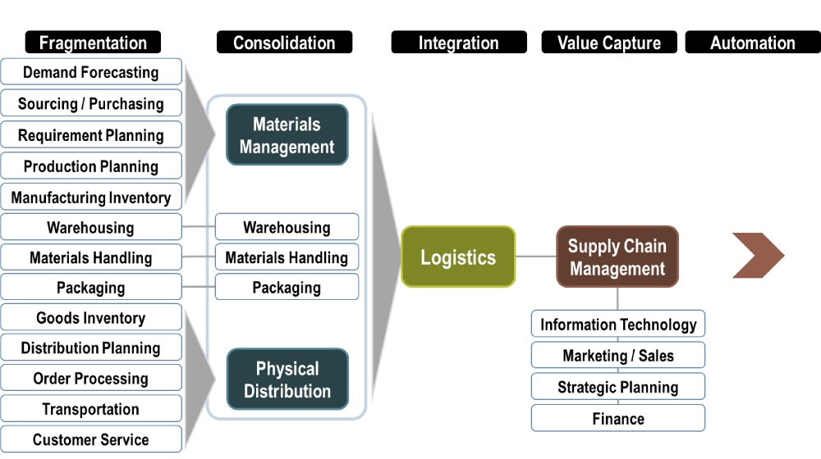
Activities Fragmentation to Integration (Supply Chain Management)
Model help us to understand that which activity could be part of integrated supply chain

Slide 39
Supply Chain Network Design Process Model
1. Define Process steps
2. Perform logistics/ Supply chain audit
Logistic location transformation team involve in every step
3. Examine network alternative
4. Conduct facility location analysis
Location selection team
5. Network/Location decision making
6. Develop implementation plan

Slide 40
Key steps involved in supply chain network design process
Step 1: Define the supply chain network design process
Step 2: Perform supply chain audit
Step 3: Develop an implementation plan

Slide 41
Step 1: Define the supply chain network design process
Become aware of overall corporate and business strategy
Parameter and objectives of the network design
Business and supply chain need
Issues pertaining to the availability of needed resource i.e funding, people, system

Slide 42
Step 2: Perform supply chain audit
Step 1: Fundamental Business Information
Step 2: Supply Chain System
Step 3: Key Supply Chain Activities
Step 4: Measurement & Evaluation
Step 5: Strategic Supply Chain Issues

Slide 43
Following information should become available in result of audit
Customer requirement and key environmental factors
Understanding of key supply chain activities and processes
Benchmark or target , Values for supply chain costs and key performance measurements.
Key supply chain goals and objectives
Profile of the current supply chain network and firms positioning in respective supply chain

Slide 44
Step 3: Develop an implementation plan
Blueprint for change will be develop, once the overall direction has been established
The plan should serve as a road map for moving from current supply chain network to the desired new one
Continuous improvement of supply chain will take place

Slide 45
Thanks

Slide 46
Discovery Phase
The discovery phase involves the following steps;
Step 1:
Data Collection
Step 2:
Data Tabulation
Step 3:
Data Verification
Step 4:
Optimize the configuration of SC-Network

Slide 47
Discovery Phase
Data Collection | Policies Order Management Processes Dispatch Quantities Freight Rate Dispatch Process Risk
Data Tabulation | Observation Implication Recommendation
Data Verification | Visit of dispatch section at respective plant sites Meeting & Discussion with dispatch staff
Optimize the configuration of SC-Network | Recommendation

Slide 48
Step 3: Data Verification
1.
Visited dispatch section at respective plant sites to verify the data which was received from marketing head office (both FCCL & ACL). During visit of plant site, we observed following dispatch practices.
2.
To present authority letter at dispatch office by the respective transporter.
3.
To verify order & dispatch schedule in ERP.
4.
To prepare loading advice according to authority letter in ERP.
5.
Gate entry.
6.
Weigh bridge – 1st weight & number for loading.

Slide 49
Step 3: Data Verification
7.
To present loading advice (loading staff) by truck driver.
8.
To load vehicle on respective turn.
9.
Weigh bridge – 2nd weight & net weight.
10.
To generate dispatch note & sale tax invoice by dispatch office.
11.
To release gate pass by security staff after checking dispatch documentation.

Slide 50
Steps Required to Design the Integrated Supply Chain Mechanism
Performing a gap analysis between the current and future states of SCM
Identifying the current and future states of SCM.
Developing an action plan to close gaps.

Slide 51
Recommended Way Forward
Sr. # | Recommendation
1 | Guide & coach the team in a collaborative approach to improve Supply Chain Maturity Level of ACL & FCCL
2 | Facilitate in review of transportation arrangement (In-bound & Out-bound)

Slide 52
3rd Deliverable Integrated Supply Chain & Logistics Organization Chart & Authority Matrix Recommendation

Slide 53
Proposed Dispatch Department Organogram

Slide 54
Recommended Way Forward
Sr. # | Recommendations
1 | Facilitate in the change process (prepare for change, plan for change, execute change & monitor change) if any of these elements are missing, change initiative can fail
2 | Facilitate in the development of supply chain department of ACL & FCCL for value chain development to improve net value.

Slide 55
4th Deliverable Review and Share Recommendations for Supply Chain and Logistics IT/ERP/MIS

Slide 56
Assessment of Supply Chain and Logistics IT/ERP/MIS

Slide 57
Technology can be source of competitive advantage for FCCL and ACL. ERP is framework for organizing, defining, and standardizing the business processes necessary to effectively plan and control an organization so the organization can use its internal knowledge to seek external advantage Modularized suite providing automated interactions and a common data source. Evolving challenge of linking together ERP systems of supply chain partners.

Slide 58
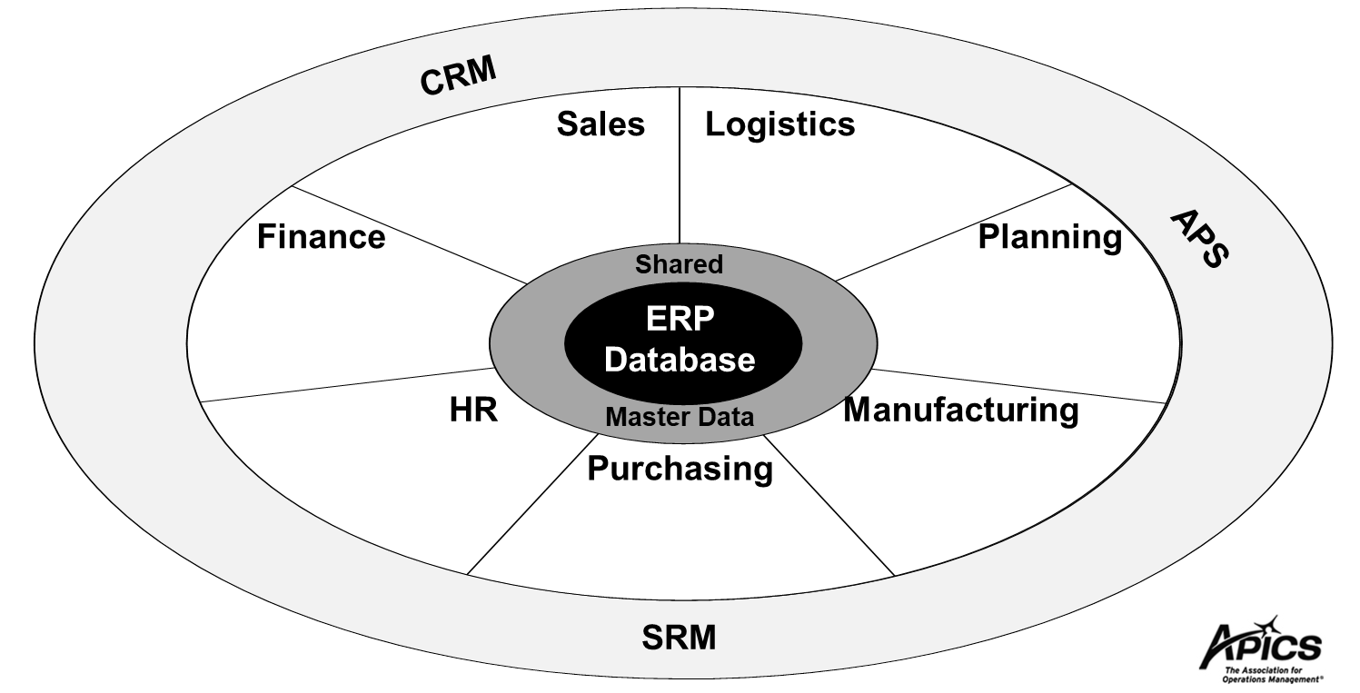

Slide 59
Role of Technology in Supply Chain Management
Supply chain management is the system that connects and integrates the links of sourcing, procurement, conversion, and logistics management. By understanding how to manage this complex system and ensure that key business functions are properly integrated, you can increase profits and reduce costs and risks. Once you have a plan for how your processes are going to mature, then you can decide which technologies you need. Select the right technologies for your supply chain.
Order Management Order request, Order process, Order preparation, Order shipment.
Inventory Management Raw material, Work in process, In-transit, MRO, Finished goods.
Distribution Management Order Invoicing, Order allocation, Order tracking.

Slide 60
Supply Chain Management key features, continued
Transport Management Decrease Freight Costs • Automated Routing and Rating • Shipment Consolidation and Load Building • Freight Audit capabilities • Improve Transportation Information Visibility • Transportation cost visibility and allocation • Improved transport information tracking and availability • Improve on-time delivery performance.
Distribution Management Order Invoicing, Order allocation, Order tracking.
Transport Management Decrease Freight Costs • Automated Routing and Rating • Shipment Consolidation and Load Building • Freight Audit capabilities • Improve Transportation Information Visibility • Transportation cost visibility and allocation • Improved transport information tracking and availability • Improve on-time delivery performance.

Slide 61
SCM-ERP (SAP-MM module, Oracle-OM module)

Slide 62
Recommended Way Forward
Sr. # | Recommendation
1 | An integrated ERP system where by the complete process from customer ordering to dispatch in conjunction to production capacities and market share, including the following Order management…., Distribution Management…, Inventory management…, Logistics Management….., Decision making, Dispatch dashboard, distribution cost, Order priority setting, distribution goals setting, cost analysis, decision making, In order to have a complete financial up-date at all time for quick decision making, it is recommended to introduce e-banking, Digital Financial Solution-DFS, Digital channel for price information & communication (Mobile app, interactive web)
2 | Without modern technology, the current concept of supply chain management would not exist so we will help to design & implement the incremental steps for technology deployment/revemp/up-date to move from department centric domain of control to focus on business processes that spans department and extended supply chain (suppliers and customers)

Slide 63
Recommended Way Forward
Sr. # | Recommendations
1 | Facilitate in the integration of ACL & FCCL dispatch department for seamless transition with their existing work process and system.
2 | Guide & coach the team in a collaborative approach with the consulting team to develop dispatch process walk through, flow chart, including activity, technology steps, authority matrix, time line, human resource skills enhancement via sharing best practices local & global standard, models & methodology, simplified to match the need of ACL & FCCL centralize distribution setup at head office
3 | It is recommended to enhance and streamline the order management processes by introducing and in some cases updating, omni channel for payment, Customer order request, Customer order form, Customer order confirmation, standard authority letter, dispatch note, sale tax invoice, This will lead to accuracy of data, improve efficiency, improve order processing time.

Slide 64
Recommendation & Way Forward
Sr. # | Recommendations
4 | An integrated ERP system where by the complete process from customer ordering to dispatch in conjunction to production capacities and market share, including the following Order management…., Distribution Management…, Inventory management…, Logistics Management….., Decision making, Dispatch dashboard, distribution cost, Order priority setting, distribution goals setting, cost analysis, decision making, In order to have a complete financial up-date at all time for quick decision making, it is recommended to introduce e-banking, Digital Financial Solution-DFS, Digital channel for price information & communication (Mobile app, interactive web)
5 | Without modern technology, the current concept of supply chain management would not exist so we will help to design & implement the incremental steps for technology deployment/revemp/up-date to move from department centric domain of control to focus on business processes that spans department and extended supply chain (suppliers and customers)
6 | Facilitate in the change process (prepare for change, plan for change, execute change & monitor change) if any of these elements are missing, change initiative can fail
7 | Facilitate in the development of supply chain department of ACL & FCCL for value chain development & to improve net value. Department alignment (Dis, define processes, routing of flows)
8 | Guide & coach the team in a collaborative approach to improve Supply Chain Maturity Level of ACL & FCCL
9 | Facilitate in review of transportation arrangement (In-bound & Out-bound)

Slide 65
Supply Chain and Logistics Deliverables
Report to Optimize: Customer Network, Warehouse Network & Fleet Network
Review and Share Recommendations for Supply Chain and Logistics IT/ERP/MIS
Integrated Supply Chain and Logistics Organization Chart and Authority Matrix Recommendation
Integrated Supply Chain and Logistics Recommendation Report

Slide 66
Step 1: Data Collection
Sr. # | Information Requisition # 1 Dated: 17July,2019 | Receive from FCCL, Dated: 07Aug,2019 | Receive from ACL
1 | Supply Chain Policies | Not applicable | No response
2 | Detailed database for existing Customer network, Warehousing, Logistics for last five years. | Not applicable | No response
3 | Process risk & strategy of Customer network, Warehousing and Logistics | Not applicable | No response
4 | Process Control on Customer network, Warehousing and Logistics | Not applicable | No response
5 | Visual flows/flow chat of your process of Customer network, Warehousing, Logistics | Not applicable | No response
6 | General terms and conditions of contracts with customers | Not applicable | No response

Slide 67
Data Collection
Sr. # | Information Requisition # 2 Dated: 26Aug,2019 | Received from FCCL | Received from ACL
1 | Standard operating procedures from point of sales up till customer/dealers delivery | Yes | Yes
2 | Sample Copy of sale order | Yes | Yes
3 | Sample of Order confirmation process | Yes | Yes
4 | Process or steps required to log an order, communication process toward next steps and whom to communicate. | Yes | Yes
5 | What steps are required to serve the order to the customer/dealers | Yes | Yes
6 | Sample Copy of dispatch note | Yes | Yes
7 | Process to log and confirm shipment in system | Yes | Yes
8 | Order serving policy and procedure or steps | Yes | Yes
9 | Ex plant delivery procedure and record keeping steps | Yes | Yes

Slide 68
Data Collection
Sr. # | Information Requisition # 2 Dated: 26Aug,2019 | Receive from FCCL | Receive from ACL
10 | Process to update the freight list along with a sample list | Yes | Yes
11 | Process to select the carriage contractor, shortlisting method and approving authority | Yes | Yes
12 | Process to evaluate the performance of carriage contractor | Yes | Yes
13 | Process to impose the penalty on non-serving order to dealers | Yes | Yes
14 | Steps to Develop and to determine the freight list | Yes | Yes
15 | Steps to develop the carriage contractor | Yes | Yes
16 | Dispatch/Logistics staff training data for last 10years | Yes | No
17 | How FCCL/ACL identify & determine customer need? | Yes | No
18 | How & where FCCL/ACL maintain customer feedback? | Yes | No

Slide 69
Data Collection
Sr. # | Information Requisition # 2 Dated: 26Aug,2019 | Receive from FCCL | Receive from ACL
19 | How FCCL/ACL ensure prompt and uninterrupted delivery of cement? | Yes | No
20 | How to monitor dispatches? | Yes | No
21 | What are business market intelligence report & results? | Yes | No
22 | How many %age of dealer’s orders book on delivered basis? | Yes | No
23 | How much deliveries in full on time (14 days)? | Yes | No
24 | How many penalties impose to truckers annually on noncompliance of in-time delivery? | Yes | No
25 | Customer survey questionnaire? | Yes | No
26 | How many complaints annually received against order processing? | Yes | No
27 | Do FCCL/ACL maintain monthly complaint summery/action? | Yes | No

Slide 70
Data Collection
Sr. # | Information Requisition # 2 Dated: 26Aug,2019 | Receive from FCCL | Receive from ACL
28 | Do FCCL/ACL record, how many times in a year, FCCL/ACL have to face risk exposure (strike, non-availability of trucks) etc.? | Yes | No
29 | Do FCCL/ACL manage loading policy with NHA load compliance? | Yes | No
30 | How FCCL/ACL improve reliability & sustainability of dispatch? | Yes | No
31 | Do FCCL/ACL manage log book for risk identification, strategy, control, implementation? | Yes | No

Slide 71
Data Collection
Sr. # | Information Requisition # 3 Dated: 02Oct,2019 | Receive from FCCL | Receive from ACL
1 | Map of all steps in ERP to complete the task, from order booking till dispatch along with all reports which generate in this regard. | Partially received | Partially received
2 | Dispatch process flow chart along with human resource involvement at each step, use of technology/ERP in the process and time line to complete the dispatch task. | Partially received | Partially received
3 | Risk list of dispatch process | Received | Partially received
4 | Risk control list of dispatch process | Received | Partially received
5 | Dispatch process Risk logbook for last 5years | Not maintained | Partially received
6 | Detail of incidental charges (loading, freight and offloading) total /year 2016, 2017 and 2018 | Partially received | Partially received

Slide 72
To conduct Customer Network optimization
To conduct customer network optimization detail database of customers and business are required i.e.
Purpose/objectivity of customer network optimization
Customer profile (location, distance, potential)
Customer order history
Customer requirements
Cost to serve the order
Distribution/transportation cost
Profitability analysis (How much profitable for organization)
Business strategy
Marketing strategy
Competitors strategy

Slide 73
To conduct Fleet Network optimization
To conduct Fleet network optimization the following data and cost analysis are required i.e.
Purpose/objectivity of Fleet network optimization
Business, Marketing and Supply chain strategy
Sales and Marketing requirement
Customer service level
Current fleet data (numbers of vehicles, capacity etc.)
Efficiency level (Delivery in full on time)
In-house vs out-source transportation cost analysis
Freight cost analysis with respect to market
Fleet capabilities analysis
Local market logistics trends
Analyze future logistics challenges

Slide 74
Objective to analyze and optimize customer, warehouse and fleet network
Key Objective: optimize costs while maintaining (or improving) a defined service level for the customers.
The objective of optimization is to do the supply chain process at the lowest cost possible, while maintaining high customer service and fast delivery. The optimize customer, warehouse and fleet network provide a standardized way to deliver cement to the customer, timely and safely up to the door step. While customers’ expectations keep increasing, requiring faster and faster shipments, companies need to re-assess their supply chain every few years in order to keep up with said increasing expectations and with the evolution of the demand.
The analysis and optimization of a customer, warehouse and fleet network can be useful in numerous situations, such as determining the best number of customer in the network, their optimal locations, the impact of consolidating divisions together (after optimization, for example), which region/zone should serve which customers, which plant should serve which customer, which warehouse should serve which customer etc.
Optimizing a customer, warehouse and fleet network is an important strategic project; it can lead up to 15% annual cost reductions (transportation costs). In order to conduct a successful customer & Fleet network optimization, some key steps have to be accomplished.

Slide 75
Steps to analyze and optimize customer and fleet network
1. Understanding the current situation
The first step is data collection process and the assessment of the current situation. it is important to gather as much information as possible on the current situation and validate its accuracy.
This step implies collecting information on customer data (ship-to addresses, required service level, etc.), orders data (SKUs, lines, backorders, etc.), shipping data (origins of shipments, carriers used, costs, etc.), warehouse transfers data (lanes of transfers, products transferred, carriers used, fix costs, variable costs, etc.).
Mapping plant locations
Listing the types of products
currently manufactured at each plant.
Regroup products by groups with specific characteristics
Understanding the source of supply of every product group
Mapping the customers
Mapping the demand (frequency of orders and quantity)
Understanding the current service level

Slide 76
Steps to analyze and optimize customer and fleet network
2. Setting up the parameters to test different scenarios
Once all relevant data has been gathered and analyzed, all the parameters that will be used to evaluate different network scenarios need to be defined. Generally, the evaluation of network strategies is done on a simulation software. Many powerful simulation tools exist, most of which are capable of simulating various network strategy scenarios. The parameters are first used to build the base case scenario (current situation) and then, to evaluate different networks strategies.
3. Designing the optimal network - Number and plant locations
The next step in designing an optimal customer and fleet network is to evaluate if the current plants are well located and if not, which location would be better to serve the customer. Some companies will prefer relocating warehouses based upon the customer location (e.g. if outbound costs are high) while others will prefer being closer to customers, allowing a better service level.
Below are some elements to consider when designing a customer & fleet network
Optimize costs or service level: The search for a balance
Best service level at the lowest cost;
A good network optimization requires finding a good balance between service level and costs;
Evaluate different scenarios and determine the best supply chain strategy (which customers are served from which plant, possibility to optimize outbound, etc.);

Slide 77

Built Upon APICS Global Standards American Production & Inventory Control Society, Chicago-USA
Global best standard for Supply Chain Management will guide to improve FCCL & ACL supply chain management.

Slide 78
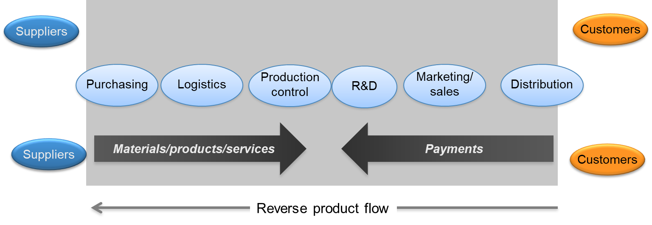
Current State of FCCL & ACL SCM
Stage 2: Semi Functional Enterprise

Slide 79
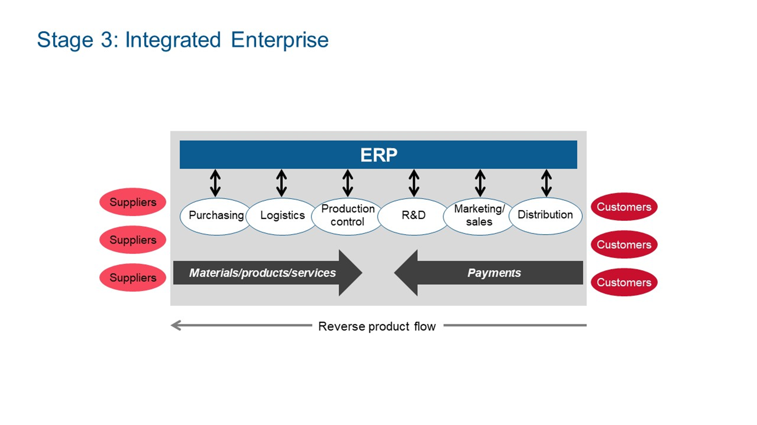
FCCL & ACL SCM Way Forward

Slide 80
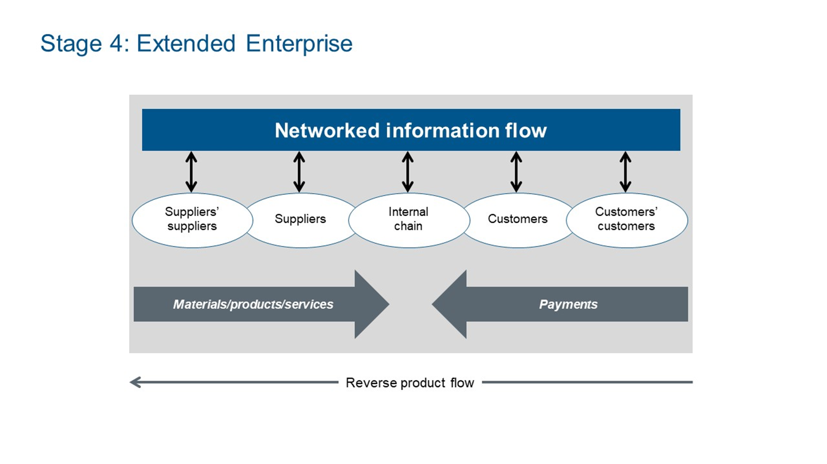
Ultimate Objective to be Achieved by FCCL & ACL Cement

Slide 81
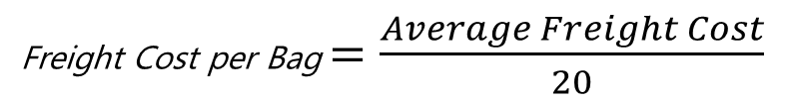
Assessment of freight cost FCCL Average Freight / Ton, per bag
High cost of transportation may limit the penetration in new territories
Average Weighted Freight Cost (AWFC) FCL = Rs.1685/ton
= Rs.84.25/bag
Average Weighted Freight Cost (AWFC) ACL-N Not provided
Average Weighted Freight Cost (AWFC) ACL-W Not provided
Total Freight Cost 2018-2019 = ?
Total Dispatch for the period of 2018-2019
FCCL = 3,037,677 Tons
ACL Nizampur = 1292752Tons
ACL Wah = 1060743Ton
Average Freight Cost$=\frac{Total Freight Cost}{Total Dispatch}$
Freight Cost per Bag $=\frac{Average Freight Cost}{20}$

Slide 82
ACL Dispatch Staff Productivity Analysis & Resource Optimization
This analyses can help to optimize the resources at dispatch section on plant site.
Total dispatch for the period of 2018-2019
ACL Nizampur = 1,292,752 Tons
ACL Wah = 1,060,743 Tons
Total dispatch staff
ACL Nizampur = 17
ACL Wah = 10
Dispatch staff productivity = Total Dispatch Qty./ Total Dispatch Staff
ACL-N dispatch staff productivity = 1,292,752/17
= 76,044/12
= 6,337 Tons/Month/Person
= 6,337/23 Days
= 275 Tons/Day/Person (09 Vehicles Documentation)
ACL-W dispatch staff productivity = 1,060,743/10
= 106,074/12
= 8,839 Ton/Month/Person
= 8,839/23 Days
= 384 Tons/Day/Person (13 Vehicles Documentation)

